Slide 1
Arduino Session Recapping
BY: Aya Ali.

Slide 2
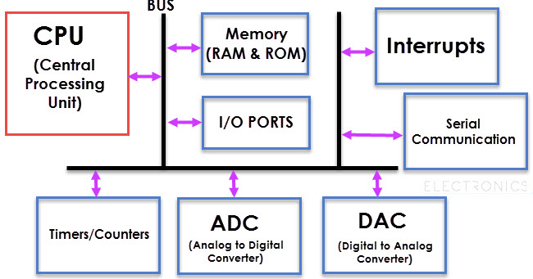
Microcontroller VS Microprocessor
CPU

Slide 3
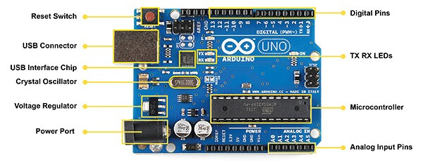
Arduino Hardware

Slide 4
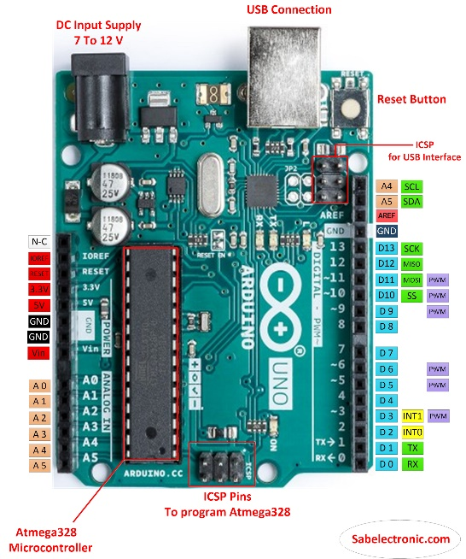

Slide 5
01
Analog Vs Digital

Slide 6
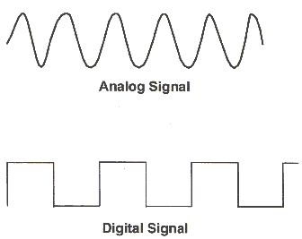

Slide 7
PWM
The type of signal can be a combination of Digital signals and Analog signals
We can control the time of any signal in it.

Slide 8
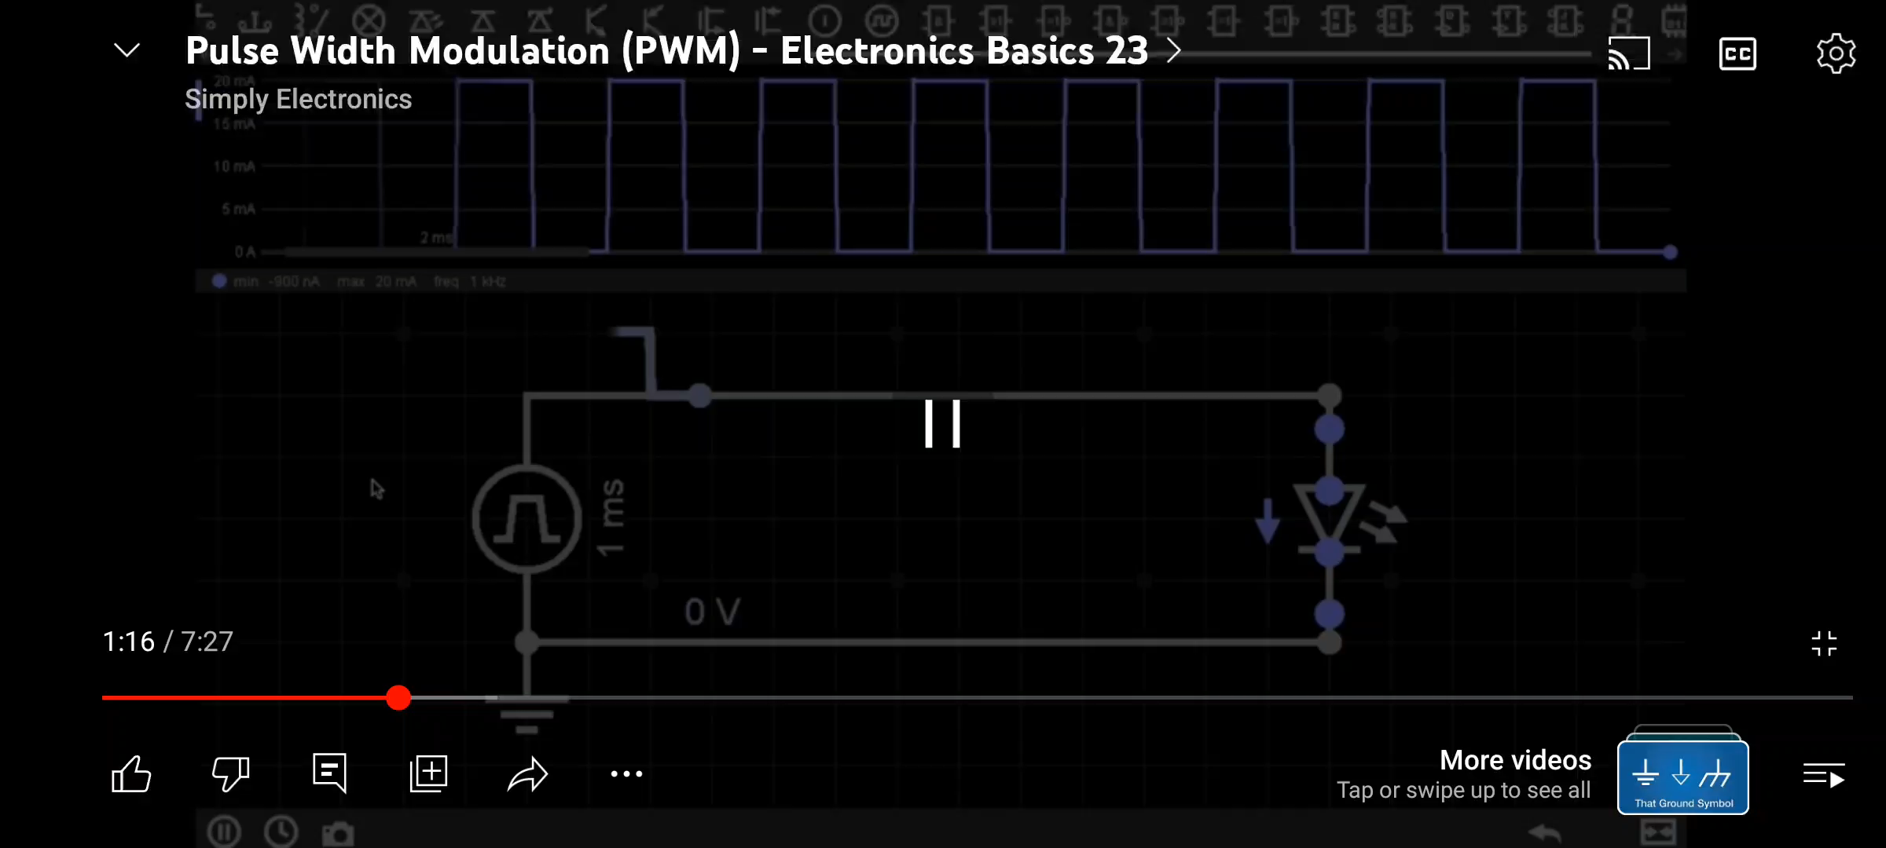

Slide 9


What is code importance?

Slide 10
Code
Some of the instructions that we write to make our robot live.
End with a semi-column.
;

Slide 11
01
Variables
02
If condition.
03
While Loop.
04
Functions.
Code Main concepts:

Slide 12
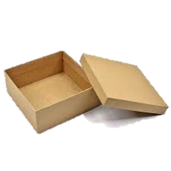
Variable
Is a container we store data in it.

Slide 13


Variable
Ayman
Same as Code we use data type to declare it.

Slide 14
Famous Data Types:
1- Int (integer).
2- Char (Character).
3- Float.
4- Double.

Slide 15
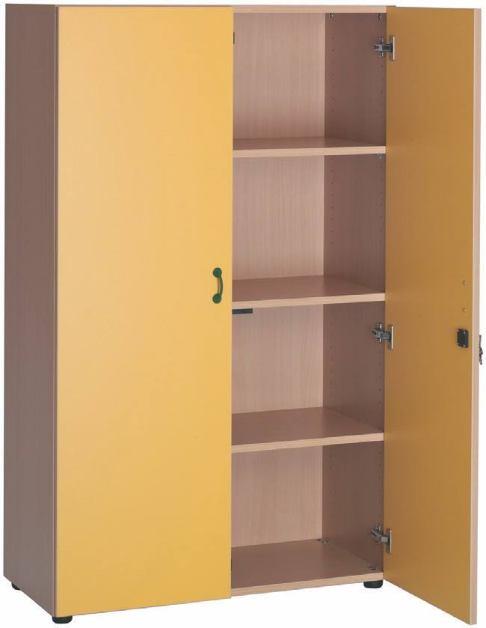
Size of each data type

Slide 16
02
declaration Vs Definition
02

Slide 17
Declaration
Definition
1-Name.
2- Data type.
1-Name.
2- Data type.
3- Initial Value.

Slide 18
Restrictions in naming Variable:
1. The variable name can’t start with a number
2. We can start it with capital Value.
3. We can start with underscore _Value.
4. If we have A name that consists of two parts we can write it as
e.g.: Value_Name, ValueName, Valuename.

Slide 19


Slide 20
1- Write a code that adds and subtracts two Numbers to/from each other.

Slide 21


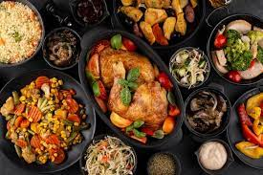
Are You hungry?

Slide 22

IF condition
Make a decision according to a condition.

Slide 23
IF Condition
If (Condition){
What is my robot going to do?
}
else {// if the condition is false go to this line if not skip it.}

Slide 24

If we Have more than Two options?

Slide 25
Nested If

Slide 26
If (Condition){
What is my robot going to do?}
else if (second condition) {
What is my robot going to do?}
else if (third condition) {
What is my robot going to do?}
else {// if all previous conditions are false go to this line if not skip it.}

Slide 27


Slide 28
1- Write a code that checks if the number is even or odd.

Slide 29

If I Want to Say Something More Than One Time

Slide 30


Slide 31
While Loop
Repeat an Instruction in a code a number of times.

Slide 32
While Loop
For
While
For (variable = start value; Variable = final value ; increment way){
Do this line if the variable is out of the range we need.
}
While (condition){
If true do this line if false, skip this line.
}

Slide 33


Slide 34
Write a code that Prints a word for a lot of times.

Slide 35
Function

Slide 36
We want to Write code that does Specific Tasks and Make the code more organized.

Slide 37
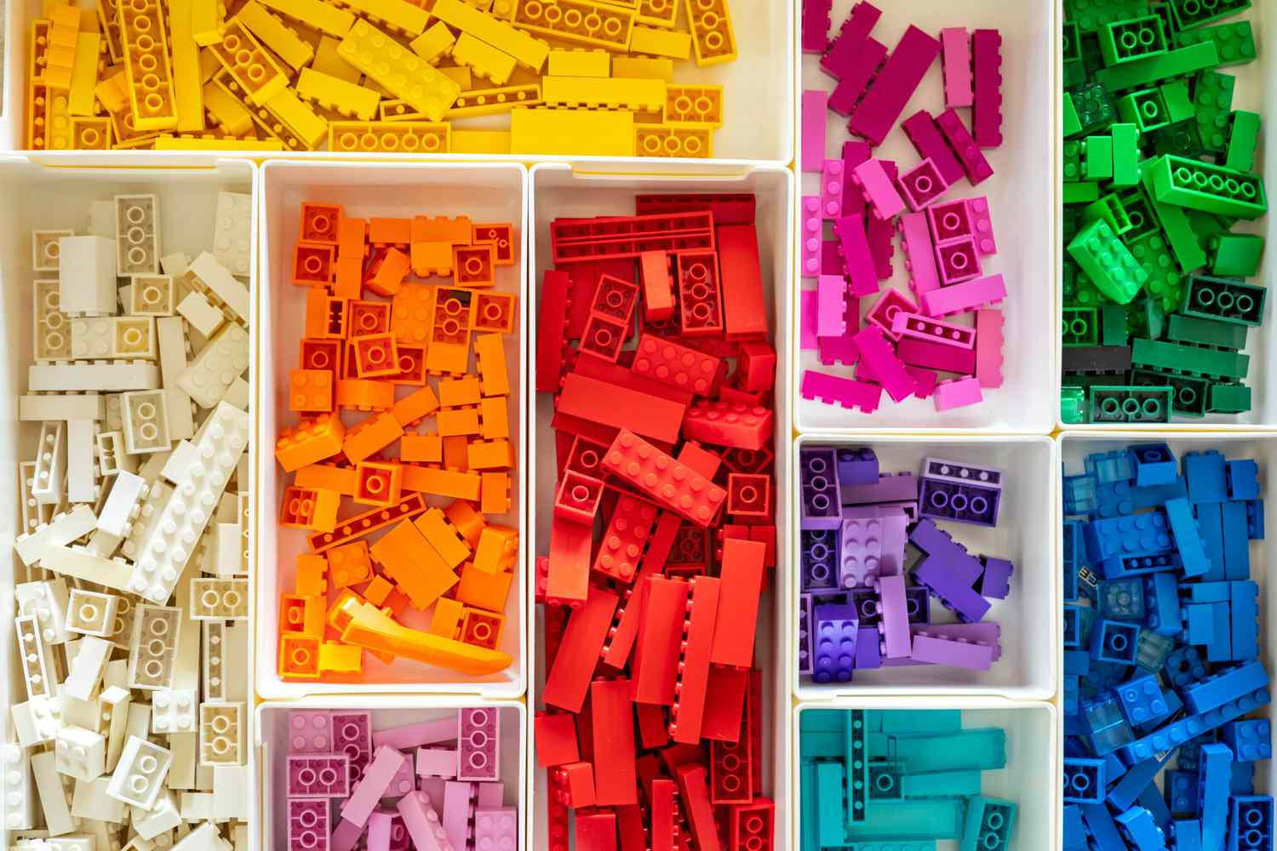

Slide 38
Famous Functions of Arduino
1- Serial.begin().
2- analogRead(pin I want to read).
3- analogwrite(pin I want to read, value I want).
4- digitalRead(pin I want to read).
5- digitalWrite(pin I want to read, value I want).
6- pinMode(pin name or number , input/ output).
7- delay(time in milliseconds).

Slide 39


Slide 40
2- Write a code that makes the 2 LEDs on and off with a delay time of 3 seconds between them.

Slide 41
Local Vs Global
Local
Global
Seen for a specific scoop in the code.
Seen for the Whole code.

Slide 42
What Is Scoop?
Anything in A {} is called a scoop.

Slide 43


Slide 44
1- Write a code that makes LED on/off with a switch by defining the LED pin as a global variable and the switch pin as a local variable.

Slide 45


Slide 46
THANKS

